Slide 1


Book Recommendation system $ Movie recommendation system Presented by :- Priyanshi Chakraborty - (C0765384) Gurpreet Singh Virdi - (C0762178) Manoj Moond - (C0761024) Parth Dhirenkumar Patel - (C0765143)

Slide 2
Tools that we use :-
Jupyter notebook
Anaconda python
pycharm
Github

Slide 3
Movie Recommendation System
By reviewing the Overview(Description) of the movies, this recommendation system advices top 10 movies.

Slide 4

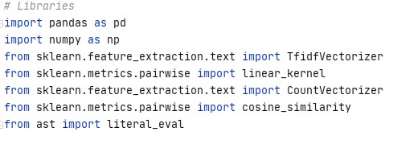
Utilities:
Libraries ::- Libraries are the collection of functions and methods that allow us to perform many actions without writing code. Here are two libraries from some of we imported in this process.
Pandas - It offers data structures and operations for manipulating numerical tables and time series.
Numpy - It offers support for large, multi-dimensional arrays and matrices, along with a large collection of high-level mathematical functions to operate on these arrays

Slide 5
The dataset files contain metadata for all 45,000 movies listed in the Full MovieLens Dataset. The dataset consists of movies released on or before July 2017. This dataset captures feature points like cast, crew, plot keywords, budget, revenue, posters, release dates, languages, production companies, countries, TMDB vote counts, and vote averages.

Slide 6
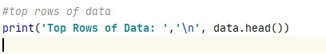
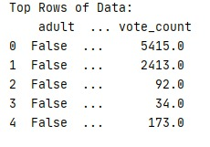
Top rows of data to have clear view about data.

Slide 7
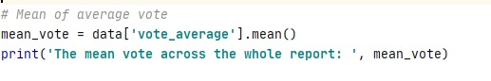
Based on the popularity votes of that movie it shows in the report.

Slide 8
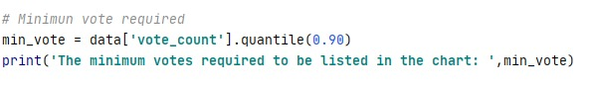
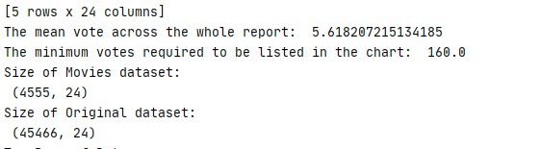
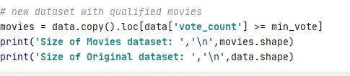
Based on minimum votes requirement criteria the list of the movies shows in the cart.
It also shows the size of that movie.

Slide 9
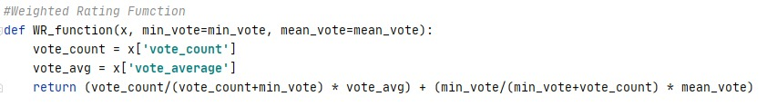
Defining WR function

Slide 10
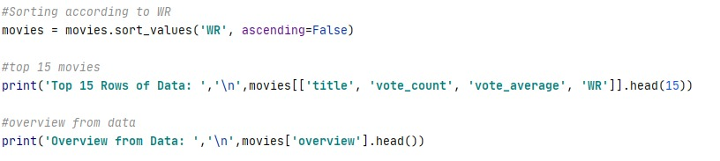
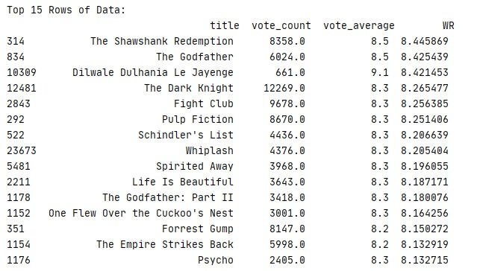
After sorting the data it shows the top 15 rows of data.

Slide 11
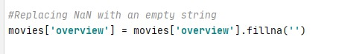
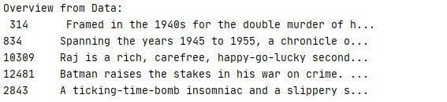
Replacing the missing values.

Slide 12
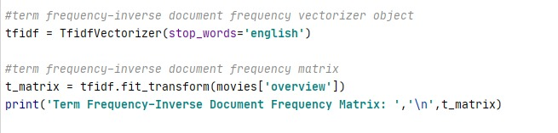
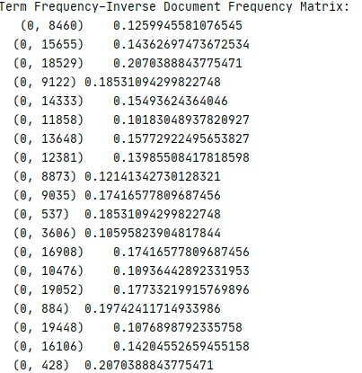

Slide 13
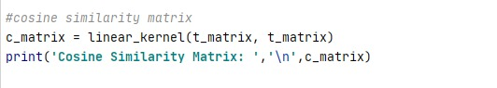
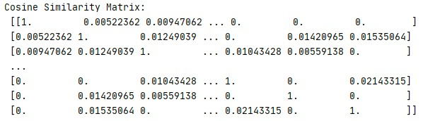
Using cosine similarity matrix

Slide 14
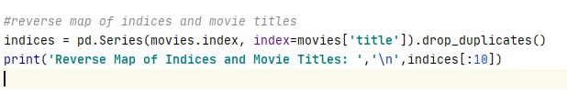
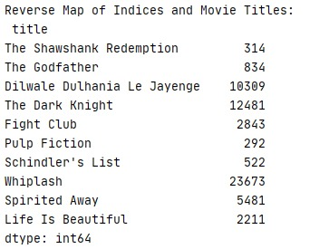

Slide 15
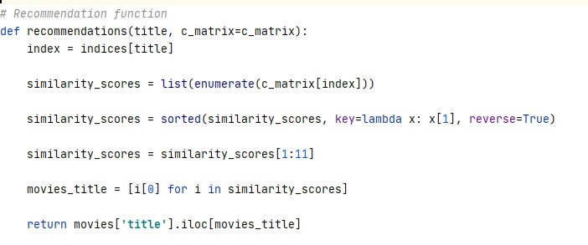

Recommendation Function:-

Slide 16
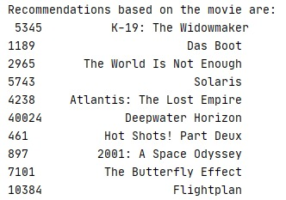
Recommendation based upon movies

Slide 17
Book Recommendation system
Build recommendation system using book title and description.
By using book title and genre generate top five similar recommended books based on the title and description.

Slide 18
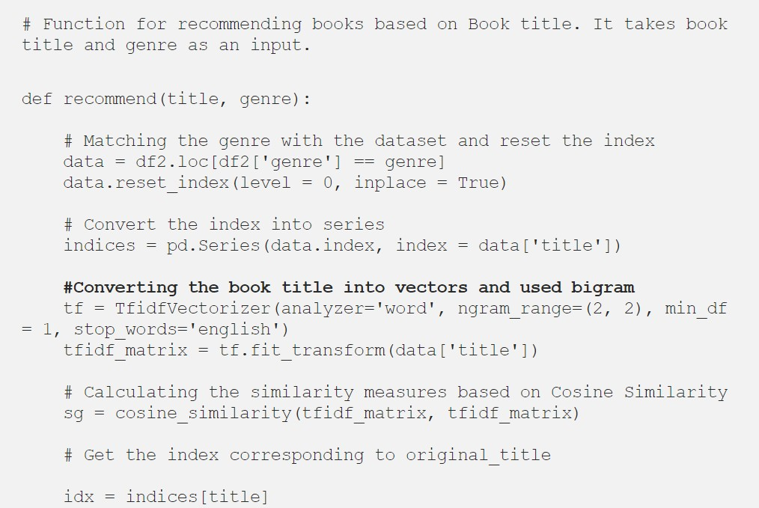
Build two recommendation engine using book title and description.

Slide 19
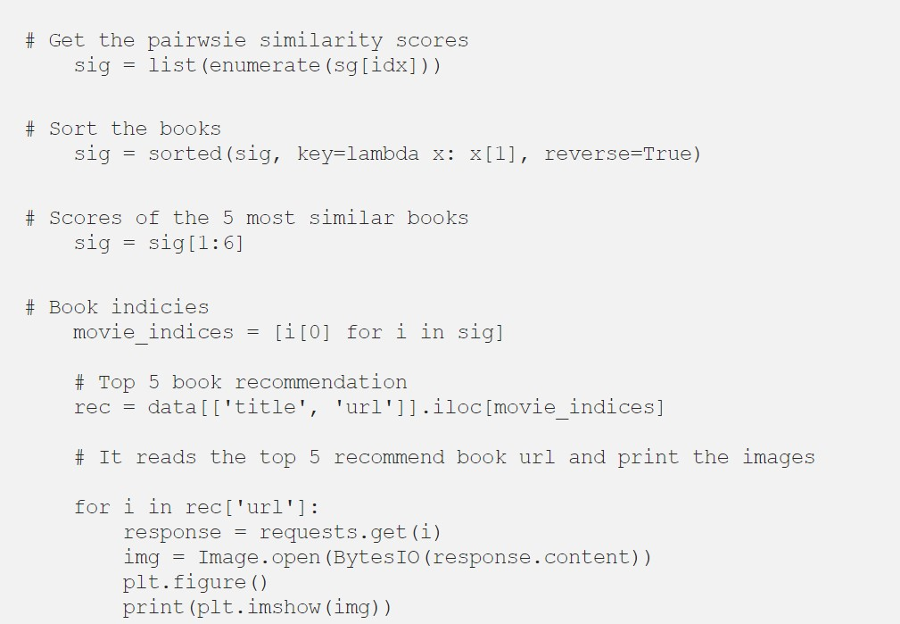
Convert each book title and description into vectors using TF-IDF and bigram. For more details on TF-IDF .

Slide 20
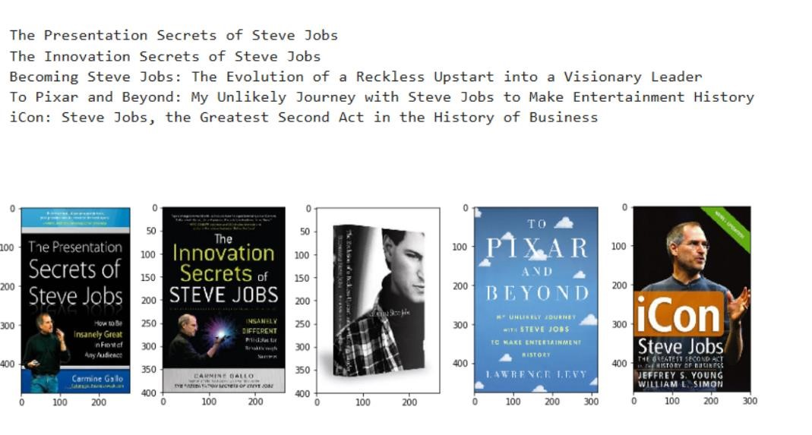
Output :-
With the implementation of the code it recommends user books based upon Steve Jobs.

Slide 21
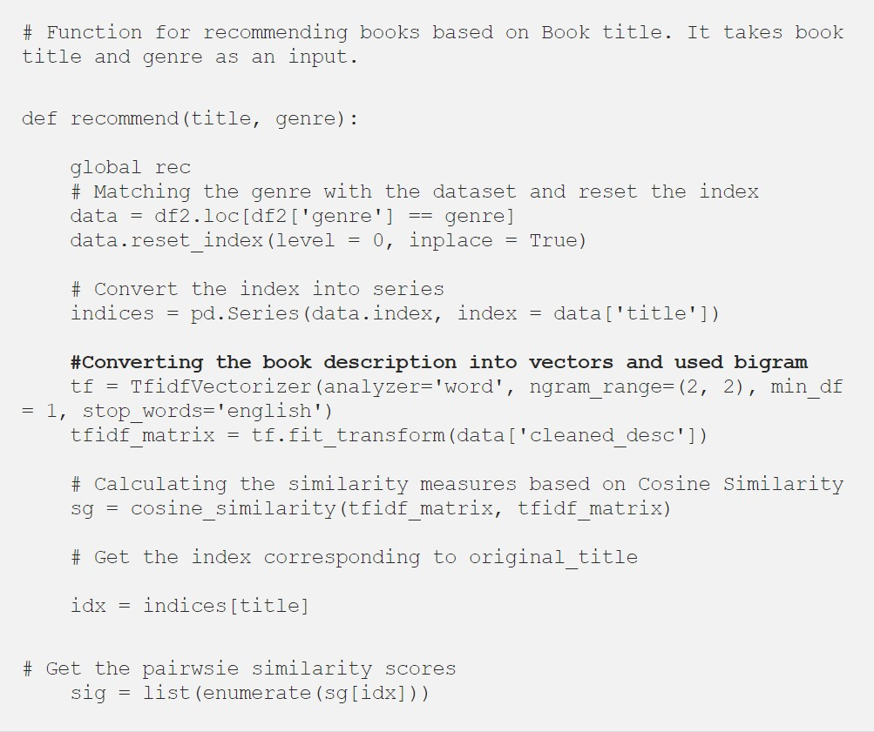
We have built two recommendation engines, one with a book title and another one with a book description. The model recommends a similar book based on title and description.

Slide 22
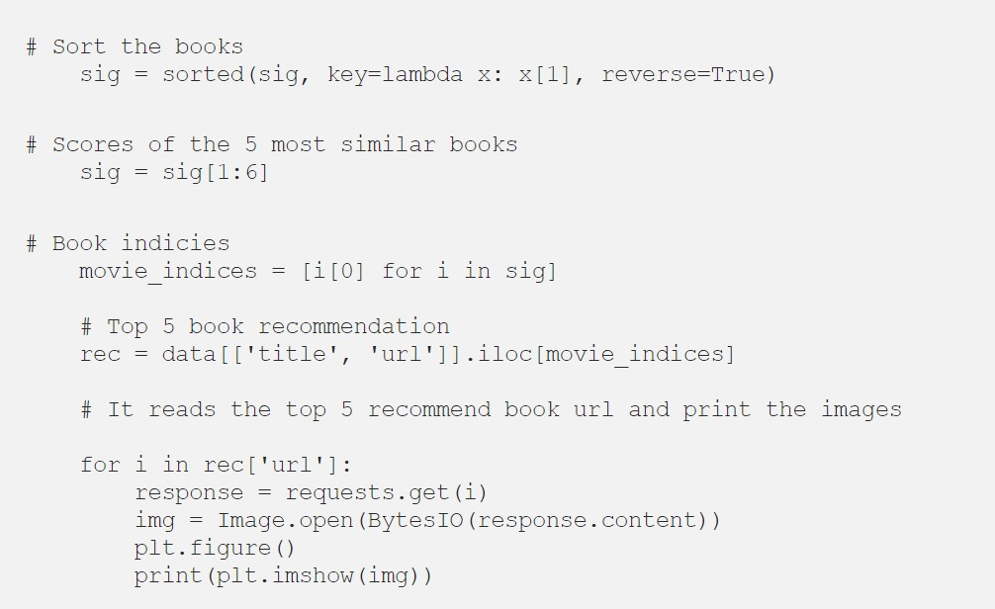
Calculate the similarity between all the books using cosine similarity.

Slide 23
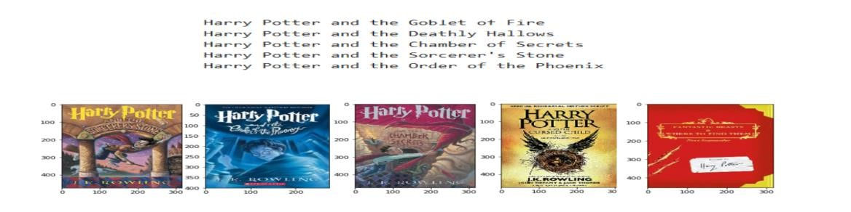
Define a function that takes book title and genre as an input and returns the top five similar recommended books based on the title and description.

Slide 24
Conclusion:-
Based upon the two-recommendation system developed by our group it is suitable for future research and project to combine both recommendation to produce a hybrid type of recommendation system. The new recommendation would help to provide suggestions based upon books and movies based upon it.

Slide 25


